Slide 1
Chapter 4 Intellectual Property Rights

Slide 2
Table of Contents
1. Introduction
2. Intellectual Property Rights
3. Protecting Intellectual Property
4. Fair Use
5. New Restrictions on Use
6. Peer-to-Peer Networks
7. Protections for Software
8. Open-Source Software
9. Legitimacy of intellectual Property Protection for Software

Slide 3
1. Introduction
Friends share all things. -Pythagoras
Today’s pirates operate not on the high seas but on the Internet.
-Recording Industry Association of America

Slide 4
1. Introduction
40% of software installed on PC worldwide and 80% of software in China was obtained illegally.
(Source: “Sixth Annual BSA-IDC Global Software 08 Piracy Study.” Business Software Alliance and IDC, May 209. www.bsa.org.)
Boston University graduate student Joel Tenenbaum was found guilty of violating copyright law by downloading and sharing 30 songs, and ordered by the jury to pay record companies $675,000.
(Source: Denise Lavoie. “Joel Tenenbaum: Jury Awards $675.000 in Boston Music Downloading Case.” HuffingtonPost, July 31, 2009. www.huffingtonpost.com.)
Half of the teenage Internet users in America admit to downloading music files.
(Source: Amanda lenhart and Mary Madden. “Teen Content Creators and Consumers.” Pew Internet & American Life Project, November 2, 2005. www.pewinternet.org)

Slide 5
1. Introduction
Consumers:
Benefits from access to high-quality music, movies, computer programs and other products of the human intellect
Producer of IP:
Do not receive all of the payments the law says they are entitled to
Creators of IP:
Receive more rights from laws compared to producer
Fair?

Slide 6
2. Intellectual Property Rights

Slide 7
2.1 What is Intellectual Property
Intellectual property (IP): any unique product of the human intellect that has commercial value
Books, songs, movies
Paintings, drawings
Inventions, chemical formulas, computer programs
Intellectual property ≠ physical manifestation
E.g. if a poet composes a new poem, the poem itself is the intellectual property, not the piece of paper on which the poem is printed

Slide 8
2.2 Property Rights
Locke: The Second Treatise of Government
People have a natural right to property
to property in their own person
to their own labor
to things which they remove from Nature through their labor
As long as
nobody claims more property than they can use
after someone removes something from common state, there is plenty left over

Slide 9
2.3 Extending the Argument to IP
Locke 🡪 about the ownership of physical objects.
How about ownership of ideas?
Compare writing a play (creating a piece of IP) similar to making a belt buckle
Make a Belt Buckle:
Mine
Smelt
Cast
Write a Play:
“mines” words
“smelts” words into prose
“cast” words into a play

Slide 10
2.3 Extending the Argument to IP
Problems:
Suppose both Ben Jonson and William Shakespeare simultaneously write down Hamlet. Who owns it?
Suppose two people make same identical belt buckle, they both can own their own ‘physical’ buckle.
Who owns the non-physical ‘Hamlet’?
Is copying IP considered stealing?
If someone found ‘Hamlet’ on a piece of paper and copy it onto another paper. He didn’t ‘steal’ the original paper with ‘Hamlet’. Is he considered stealing?

Slide 11
2.4 Benefits of IP Protection
Some people are altruistic (like to share), some are not
Allure of wealth can be an incentive for speculative work:
If a person has the right to control the distribution and use of a piece of IP, there are many opportunities for that person to make money.
On the other hand, it is possible to be rewarded for creativity without the new IP ever reaching the public.
E.g. selling newly invented mousetrap license to a company that dominates the market. Te market might not want to manufacture the new mousetrap because of certain reason. Then the society is deprived access to the new, improved technology.
Notes:
Altruistic – unselfish

Slide 12
2.5 Limits to Intellectual property Protection
Society benefits the most when inventions are in the public domain and anyone can take advantage of them.
Tension:
The need to reward the creators of IP by giving them exclusive rights to their ideas
The need to disseminate the ideas as widely as possible so that society can benefit from it.
Solution: limited period of time for IP rights.
Notes:
Altruistic – unselfish

Slide 13
2.5 Limits to Intellectual property Protection
Example:
“Happy Birthday to You” song is copyrighted in 1935 by the publisher Clayton F.Summy Company (now a subsidiary of TimeWarner) under the Copyright Term Extension Act of 1998 until 2030.
TimeWarner collects about $2 million in royalties each year for public performance of “Happy Birthday to You”.
In 2015 September, the copyright is claimed to be invalid for the lyrics.
Notes:
Altruistic – unselfish

Slide 14
3. Protecting Intellectual Property

Slide 15
3.1 Trade Secrets
Definition: Confidential piece of intellectual property that gives company a competitive advantage
Never expires:
E.g. Coca-Cola has kept its formula secret for more than 100 years
Not appropriate for all intellectual properties
E.g. movie cannot be kept confidential because company can only profit by allowing it to be viewed.
Notes:
Altruistic – unselfish

Slide 16
3.1 Trade Secrets
“Reverse engineering” is allowed:
E.g. if a company purchase a can of Coca-Cola and figure out the formula, it is free to manufacture a soft drink that looks and tastes just like Coke.
May be compromised when employees leave firm:
Although the employees sign confidentiality agreements, it cannot erase the memories of an employee who starts working for a competing firm.
Notes:
Altruistic – unselfish

Slide 17
3.2 Trademarks and Service Marks
Trademarks:
A word, symbol, picture, sound, or color used by a business to identify goods.
Used to establish “brand name”
Branding allows consumers to have more confidence in the quality of the products they purchase
Some brand name eventually become a common noun used to describe any similar product, e.g. “yo yo”, “aspirin”, “thermos”, “escalator”.
Notes:
Altruistic – unselfish

Slide 18
3.2 Trademarks and Service Marks
Trademark:
A way to avoid trademarks to become generic is through advertisement to ensure brand name is used as adjectives rather than nouns or verbs.
Another way is to contact those who misuse the brand name:
E.g. “photoshopping” image is wrong.
Service Mark:
A mark identifying a service
Notes:
Altruistic – unselfish

Slide 19
3.3 Patents
A public document that provides detailed description of invention
Provides owner with exclusive right to the invention
Owner can prevent others from making, using, or selling invention for 20 years
Notes:
Altruistic – unselfish

Slide 20
3.3 Patents
Requirements for obtaining a patent
Must be a patentable subject matter
Must be new (Novelty)
Must be non-obvious/inventive
Must be useful (Utility)

Slide 21
3.4 Copyrights
Provides owner of an original work five rights
Reproduction
Distribution
Public display
Public performance
Production of derivative works
Copyright-related industries represent 5% of U.S. gross domestic product (> $500 billion/yr)
Copyright protection has expanded greatly since 1790
Notes:
Altruistic – unselfish

Slide 22
3.4 Copyrights
Some court cases and legislation that define the limits of copyright in the United States:
Gershwin Publishing Corporation v. Columbia Artists Management, Inc.
Basic Books v. Kinko’s Graphics Corporation
Davey Jones Locker
No Electronic Theft Act
Notes:
Altruistic – unselfish

Slide 23
3.4 Copyrights
Lots of avenues, including copyright and patent, exist under the law to protect IP. Both patents and copyrights protect software from theft under the law. Each one protects a different part of the software. Patents protect the idea, while copyright protects the written code.
https://www.upcounsel.com/software-patent-or-copyright

Slide 24
4. Fair Use

Slide 25
4. Fair Use
Sometimes it is legal to reproduce a copyrighted work without permission
Courts consider four factors
Purpose and character of use
An educational use is more likely to be permissible than a commercial use
Nature of work
Use of nonfiction is more likely to be permissible than use of fiction. Published works are preferred over unpublished works.
Amount of work being copied
Brief excerpts are more likely to be permissible than entire chapters.
Affect on market for work
Use of out-of-print material is more likely to be permissible than use of a readily available. A spontaneously chosen selection is better than an assigned reading in the course syllabus.
Notes:
Altruistic – unselfish

Slide 26
4. Fair Use
Example 1:
A professor puts a few journal articles on reserve in the library and makes them assigned reading for the class. Some students in the class complain that they cannot get access to the articles because other students always seem to have them checked out. The professor scans them and posts them on his Web site. The professor gives the students in the class the password they need to access the articles in his Web site.
Discussion: Fair use?
Notes:
Altruistic – unselfish

Slide 27
4.1 Sony v. Universal City Studios
Sony introduces Betamax VCR (1975)
People start time shifting TV shows
Movie studios sue Sony for copyright infringements
U.S. Supreme Court rules (5-4) that time shifting is fair use
Notes:
Altruistic – unselfish

Slide 28
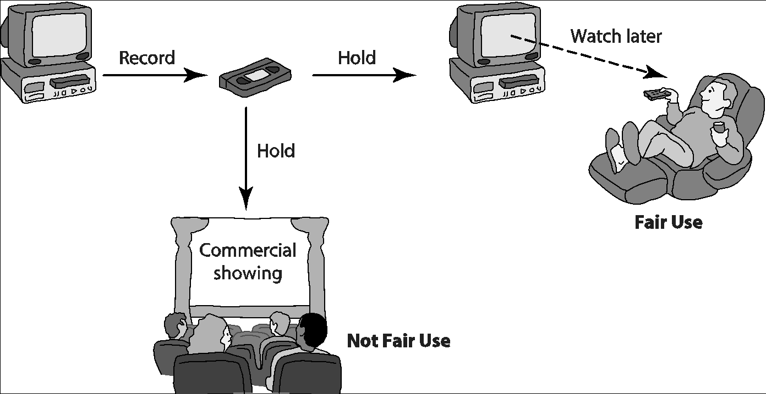
4.1 Sony v. Universal City Studios
Notes:
Altruistic – unselfish

Slide 29
4.2 Digital Recording Technology
Copying from vinyl records to cassette tapes introduced hiss and distortions
Introduction of compact disc a boon for music industry
Cheaper to produce than vinyl records
Higher quality
Higher price ⇒ higher profits
Digital recording device: to make a perfect copy of a CD
In mid-1980s, Sony began selling digital audio tape (DAT) recorders in Japan and Europe. The Recording Industry Association of America opposed the introduction of DAT.
Notes:
Altruistic – unselfish

Slide 30
4.3 Audio Home Recording Act of 1992
Copying from vinyl records to cassette tapes introduced hiss and distortions
Introduction of compact disc a boon for music industry
Cheaper to produce than vinyl records
Higher quality
Higher price ⇒ higher profits
Digital recording device: to make a perfect copy of a CD
In mid-1980s, Sony began selling digital audio tape (DAT) recorders in Japan and Europe. The Recording Industry Association of America opposed the introduction of DAT.
Notes:
Altruistic – unselfish

Slide 31
4.3 Audio Home Recording Act of 1992
Protects rights of consumers to make copies of analog or digital recordings for personal, noncommercial use
Backup copy
Give to family member
Digital audio recorders must incorporate Serial Copyright Management System (SCMS), so consumers can’t make a copy of a copy
A royalty must be paid on the sale of all digital audio recording devices and blank digital audio recording to songwriters, music publishers, musicians, and recording companies, based on the popularity of their music.
Notes:
Altruistic – unselfish

Slide 32
4.4 RIAA v. Diamond Multimedia Systems Inc.
MP3 compression allows songs to be stored in 10% of the space, with little degradation
Diamond introduces Rio MP3 player (1998)
People start space shifting their music
RIAA starts legal action against Diamond for violation of the Audio Home Recording Act
U.S. Court of Appeals, 9th Circuit, affirms that space shifting is consistent with copyright law
Notes:
Altruistic – unselfish

Slide 33
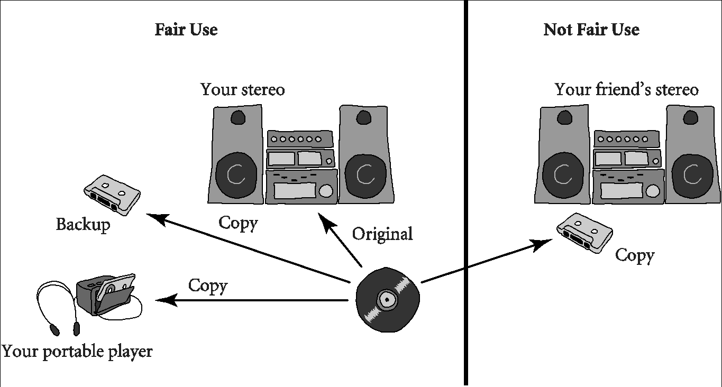
4.4 RIAA v. Diamond Multimedia Systems Inc.
Notes:
Altruistic – unselfish

Slide 34
4.5 Kelly v. Arriba Soft Corporation
Kelly: Photographer maintaining Web site with copyrighted photos
Arriba Soft: Creates search engine that returned thumbnail images
Kelly sues Arriba Soft for copyright infringement
U.S. Court of Appeals, 9th Circuit, affirms that use of images is a fair use
Notes:
Altruistic – unselfish

Slide 35
4.6 Google Books
Google announced plan to scan millions of books held by several huge libraries, creating searchable database of all words
If public domain book, system returns PDF
If under copyright, user can see a few sentences; system provides links to libraries and online booksellers
Authors Guild and publishers sued Google for copyright infringement
Out-of-court settlement under review by U.S. District Court for Southern District of New York
Notes:
Altruistic – unselfish

Slide 36
4.6 Google Books
Settlement:
Google would pay $125 million to resolve legal claims of authors and publishers and establish Book Rights Registry
Readers would have much easier access to out-of-print books at U.S. public libraries and university libraries
University libraries could purchase subscriptions giving their students access to collections of some of the world’s greatest libraries
Authors and publishers would receive payments earned from online access of their books, plus share of advertising revenues
Notes:
Altruistic – unselfish

Slide 37
4.6 Google Books
March 2011: U.S. District Court for Southern District of New York rejected proposed settlement
Judge ruled agreement would have:
Given Google significant advantage over competitors
Rewarded Google for “wholesale copying of copyrighted words without permission”
Given Google liberal rights over orphaned works
Notes:
Altruistic – unselfish

Slide 38
5. New Restrictions on Use

Slide 39
5. New Restrictions on Use
Digital copying is stimulated by broadband Internet connections
As a result, the US music industry sales and licensing revenue has dropped from $14.6 billion in 1999 to $6.3 billion in 2009.
Government and recording companies have responded to the threat of illegal copying of copyrighted materials by introducing new legal and technological restrictions on copying
Notes:
Altruistic – unselfish

Slide 40
5.1 Digital Millennium Copyright Act (DMCA)
First big revision of copyright law since 1976
Brought U.S. into compliance with Europe
Extended length of copyright
Extended copyright protection to music broadcast over Internet
Made it illegal for anyone to
Circumvent encryption schemes placed on digital media
Circumvent copy controls, even for fair use purposes
Notes:
Altruistic – unselfish

Slide 41
5.2 Digital Rights Management (DRM)
Any of actions owners of intellectual property may take to protect their rights
DRM technologies:
Encrypt digital content
Digital marking so devices can recognize content as copy-protected
Notes:
Altruistic – unselfish

Slide 42
5.3 Secure Digital Music Initiative (SDMI)
Goals
Create copy-protected CDs
Secure digital music downloads
Consortium of 200 companies developed “digital watermarking” scheme
Failed
Internet copying became huge before SDMI ready
Some SDMI sponsors were electronics companies
Digital watermarking encryption cracked
Notes:
Altruistic – unselfish

Slide 43
5.4 Sony BMG Music Entertainment Rootkit
Millions of audio CDs shipped with Extended Copy Protection, a DRM system
Prevented users from
Ripping audio tracks into MP3 format
Making more than 3 backup copies
Relied upon Windows “rootkit” that hid files and processes; usually only hackers use rootkits
Huge public outcry once secret uncovered
Sony BMG stopped production and compensated consumers
Notes:
Altruistic – unselfish

Slide 44
5.5 Encrypting DVDs
Contents of DVDs encrypted using Content Scramble System (CSS)
Need decryption keys to view a DVD
Jon Johansen wrote a decryption program for Linux
2600 Magazine published the code
Motion picture studios sued 2600 Magazine and won
Johansen tried in Norway and found not guilty
Notes:
Altruistic – unselfish

Slide 45
5.6 Foiling HD-DVD Encryption
Hardware, software, and entertainment companies created Advanced Access Content System to encrypt HD-DVDs
Dencryption key posted on Digg.com
AACS leaned on Digg.com to censor postings containing key
Digg users fought back
AACS “expired” the key and issued a new one
A month later, a Digg user posted the new key
Notes:
Altruistic – unselfish

Slide 46
5.7 Criticisms of Digital Rights Management
Any technological “fix” is bound to fail
DRM undermines fair use
DRM could reduce competition
Some schemes make anonymous access impossible
Notes:
Altruistic – unselfish

Slide 47
5.8 Online Music Stores Drop DRM
When iTunes Music Store opened, all music was protected with a DRM scheme called FairPlay
FairPlay blocked users from freely exchanging purchased music
Songs couldn’t be played on more than 5 different computers
Songs couldn’t be copied onto CDs more than 7 times
Songs purchased from iTunes Store wouldn’t play on non-Apple devices
DRM-protected music purchased from other online retailers couldn’t be played on iPod
Notes:
Altruistic – unselfish

Slide 48
5.8 Online Music Stores Drop DRM
Consumers complained about restrictions associated with DRM
European governments put pressure on Apple to license FairPlay or stop using DRM
Amazon reached an agreement with all four major music labels to sell DRM-free music
Apple followed suit in 2009
Notes:
Altruistic – unselfish

Slide 49
5.9 Malaysia IP Legislation
Intellectual Property Corporation of Malaysia Act
Patent Acts (Amendments & Regulations)
Trade Mark Acts (Amendments & Regulations)
Industrial Design Acts (Amendments & Regulations)
Copyright Acts (Amendments & Regulations)
Geographical Indications Acts (Amendments & Regulations)
IC Layout Design Acts
(Source: http://www.myipo.gov.my/perundangan)
Notes:
Altruistic – unselfish

Slide 50
6. Peer-to-Peer Networks

Slide 51
6. Peer-to-Peer Networks
Peer-to-peer network
Transient network
Connects computers running same networking program
Computers can access files stored on each other’s hard drives
How P2P networks facilitate data exchange
Give each user access to data stored in many other computers
Support simultaneous file transfers among arbitrary pairs of computers
Allow users to identify systems with faster file exchange speeds
Notes:
Altruistic – unselfish

Slide 52
6.1 Napster
Peer-to-peer music exchange network
Began operation in 1999
Sued by RIAA for copyright violations
Courts ruled in favor of RIAA
Went off-line in July 2001
Re-emerged in 2003 as a subscription music service
Notes:
Altruistic – unselfish

Slide 53
6.2 FastTrack
Second-generation peer-to-peer network technology
Used by KaZaA and Grokster
Distributes index among large number of “supernodes”
Cannot be shut down as easily as Napster
Notes:
Altruistic – unselfish

Slide 54
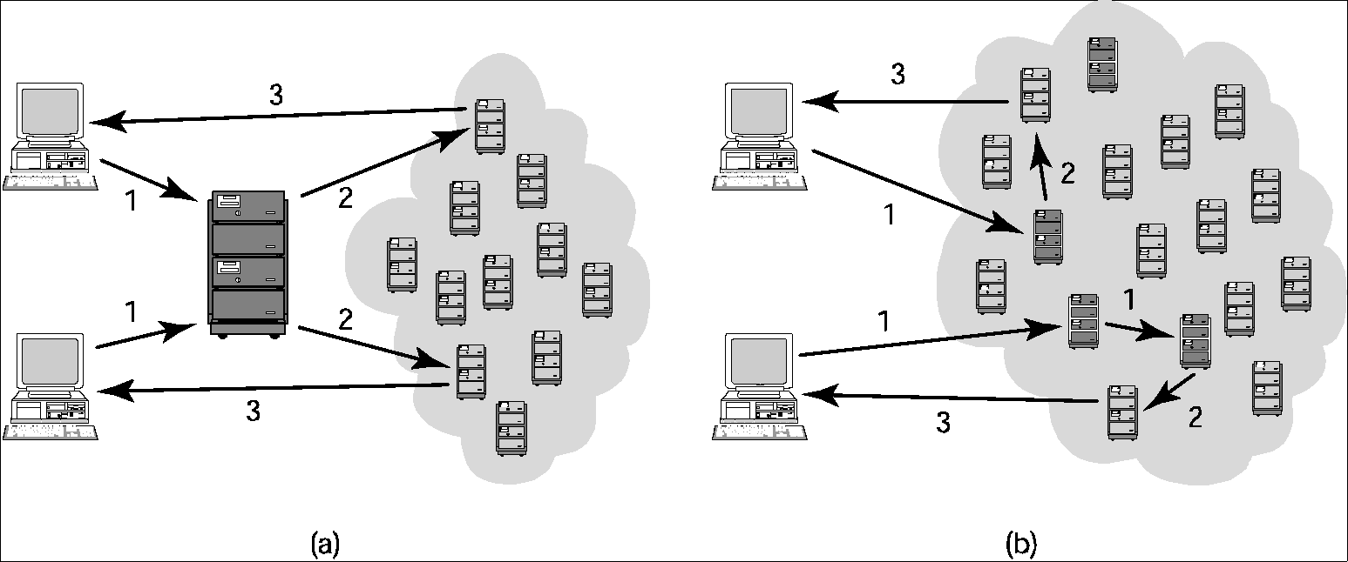
6.2 FastTrack
Comparing Napster and FastTrack
Notes:
Altruistic – unselfish

Slide 55
6.3 BitTorrent
Broadband connections: download much faster than upload
BitTorrent speeds downloading
Files broken into pieces
Different pieces downloaded from different computers
Used for downloading large files
Computer programs
Television shows
Movies
Notes:
Altruistic – unselfish

Slide 56
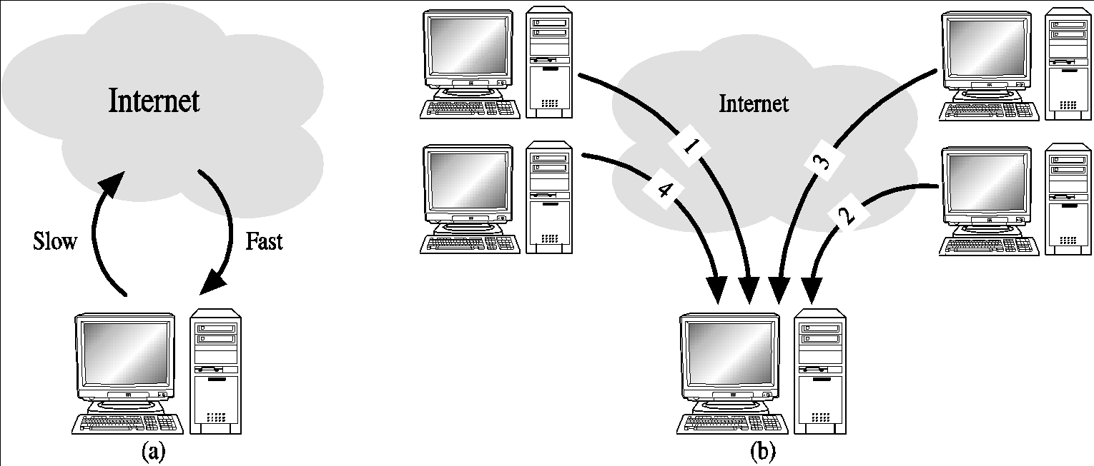
6.3 BitTorrent
Concept behind BitTorrent
Notes:
Altruistic – unselfish

Slide 57
6.4 RIAA Lawsuits
April 2003: RIAA warned file swappers they could face legal penalties
RIAA subpoenaed Verizon for identities of people suspected of running supernodes
Judge ruled in favor of Verizon
September 2003: RIAA sued 261 individuals
December 2003: U.S. Court of Appeals ruled Verizon did not have to give customer names to RIAA
Notes:
Altruistic – unselfish

Slide 58
6.4 RIAA Lawsuits
Jammie Thomas-Rassert
Federal jury ordered her to pay $1.92 million
Damages reduced to $54,000
Joel Tenenbaum
Jury ordered him to pay $675,000
Judge reduced award to $67,500
Does RIAA have to prove someone actually copied the songs that people made available on Kazaa?
New York decision: No
Massachusetts, Arizona decisions: Yes
Notes:
Altruistic – unselfish

Slide 59
6.5 MGM v. Grokster
Entertainment industry interests sued Grokster and StreamCast for the copyright infringements of their users
Lower courts
Granted Grokster and StreamCast a summary judgement
Cited Sony v. Universal City Studios as a precedent
U.S. Supreme Court
Reversed the lower court ruling in June 2005
Proper precedent Gershwin Publishing Corporation v. Columbia Artists Management
Notes:
Altruistic – unselfish

Slide 60
6.6 Legal Action Against The Pirate Bay
The Pirate Bay located in Stockholm, Sweden
One of world’s biggest BitTorrent file-sharing sites
People download songs, movies, TV shows, etc.
After 2006 raid by police, popularity increased
In 2008 the International Federation of the Phonographic Industry sued four individuals connected with site
Defendants said The Pirate Bay just a search engine
Found guilty; sentence to prison and fined $6.5 million
Meanwhile, The Pirate Bay still operational
Notes:
Altruistic – unselfish

Slide 61
6.6 Legal Action Against The Pirate Bay
The Pirate Bay located in Stockholm, Sweden
One of world’s biggest BitTorrent file-sharing sites
People download songs, movies, TV shows, etc.
After 2006 raid by police, popularity increased
In 2008 the International Federation of the Phonographic Industry sued four individuals connected with site
Defendants said The Pirate Bay just a search engine
Found guilty; sentence to prison and fined $6.5 million
Meanwhile, The Pirate Bay still operational
Notes:
Altruistic – unselfish

Slide 62
6.7 Legal Music Services on the Internet
Subscription services for legal downloading
Some based on monthly fee; some free
Consumers pay for each download
Apple’s iTunes Music Store leading service, surpassing WalMart as top music retailer in United States
Still, illegal downloading far more popular than legal music services
Notes:
Altruistic – unselfish

Slide 63
7. Protections for Software

Slide 64
7.1 Software Copyrights
Copyright Act of 1976 explicitly recognizes that software can be copyrighted
Copyright:
Protects the expression of an idea, not the idea itself
E.g. you develop a program for a relational DBMS. You may be able to copyright your implementation of a relational DBMs, but you cannot copyright the concept of using relational databases to store information.
Protects the object (executable) program, and source program.
Company only distributes the object program to its customers. The source code is confidential.
Protects the screen displays produced by the program as it executes.
Especially for video games.
Notes:
Altruistic – unselfish

Slide 65
7.2 Violations of Software Copyrights
The holder of a copyright has a right to control the distribution of the copyrighted material (making copies of the program).
Violations:
Copying a program onto a CD to give or sell to someone else
Preloading a program onto the hard disk of a computer being sold
Distributing a program over the Internet
Notes:
Altruistic – unselfish

Slide 66
7.3 Software Patents
Until the early 1980s, the US Patent and Trademark Office refused to grant patents for computer software.
In the following years, US court ruled that software should be patentable.
Since then, hundreds of thousands of software patents have been granted.
Company holding patents can sell the patents.
Some companies specialize in holding patents and licensing the rights to use these patents.
Notes:
Altruistic – unselfish

Slide 67
7.3 Software Patents
Consequence of software patents:
Large number of “bad patents” – patents that would not have been issued if the examiner knew about all of the prior art.
Any company releasing a new product that includes software runs a significant risk of being sued for infringing a software patent owned by someone else.
Some large corporations are resorting to building stockpiles of their own patents, so that if they are sued for infringing another company’s patent, they can retaliate with their own patent infringement counter-suit.
Notes:
Altruistic – unselfish

Slide 68
7.4 Safe Software Development
Be careful of unconscious copying
Programmers move from one company to another
Programmers might unintentionally produce ex-company’s software (unconscious copying)
This infringe copyright
Solution: “clean room” software development strategy
First team examine competitor’s product and produce technical specification for new software product.
Second team is isolated from first team and develop, code and debug the new software solely based on the technical specification produced by first team.
Notes:
Altruistic – unselfish

Slide 69
8. Open-Source Software

Slide 70
8.1 Consequences of Proprietary Software
Proprietary (owned) software:
To control the distribution of company’s intellectual property.
Treat source code as a trade secret and distributing only the object code (not in human-readable form).
In fact, people is buying license to allow them to run the program but not to view, backup, modify the code.
Notes:
Altruistic – unselfish

Slide 71
8.1 Consequences of Proprietary Software
Richard Stallman critics proprietary software with numerous harmful consequences:
Infringe liberties of create copies on proprietary software
The purpose of copyright should promote progress in the computer software field, but now people use it for wealth.
It is wrong to allow someone to “own” a piece of intellectual property. You need to choose between respecting ownership rights and helping your friend by giving them free copy of software. “Cooperation is more important than copyright”
Notes:
Altruistic – unselfish

Slide 72
8.2 “Open Source” Definition
Key characteristics:
No restrictions preventing others from selling or giving away the software
The source code must be included in the distribution or easily available by other means (e.g. downloadable)
No restrictions preventing people from modifying the source code, and derived works can be distributed according to the same license terms as the original program
No restrictions on how to use the software
Apply to everyone receiving redistributions of the software without the need for additional licensing agreements
The license cannot put restriction on other software that is part of the same distribution. E.g. a program’s open-source license cannot require all of the other programs on the CD to be open source.
Notes:
Altruistic – unselfish

Slide 73
8.2 “Open Source” Definition
Open-source program can be distributed for free or sell it.
Open Source Initiative (www.opensource.org) – nonprofit organization promotes a common definition of open source
Notes:
Altruistic – unselfish

Slide 74
8.3 Beneficial Consequences of Open-Source Software
Give opportunity to everyone to improve the software 🡪 evolves quickly
New version of program appear much more frequently than new versions of commercial programs. Users do not have to wait long for bug fixes and patches.
Eliminates the tension between obeying copyright law and helping others.
Open-source programs are the property of the entire user community. Improvements are always proceeding.
Shift the focus from manufacturing to service, which can result in customers getting better support for their software.
Company can make money by providing support.
Notes:
Altruistic – unselfish

Slide 75
8.4 Examples of Open-Source Software
BIND provides DNS (domain name service) for the entire Internet.
Apache runs about half of the world’s Web servers.
Android – best-selling smartphone platform
Firefox
OpenOAffice.org
Perl
GNU compilers for C, C++, Fortran, Java and Ada.
Notes:
Altruistic – unselfish

Slide 76
8.5 Impact of Open-Source Software
Impact of Linux:
1 2004 survey of 140 large North American firms by Forrester Research revealed that slightly more than half of them were using Linux for “mission-critical” and new applications.
Linux is also putting pressure on Microsoft and Apple which sell proprietary operating systems for desktop computers.
Notes:
Altruistic – unselfish

Slide 77
8.6 Critique of the Open-Source Software Movement
If a particular open-source project does not attract a critical mass of developers, the overall quality of the software can be poor.
Code forking problem
Relatively weak graphical user interface. That’s why open-source systems have made greater inroads as servers than as desktop systems
Poor mechanism for stimulating innovation. Open-source movement is able to produce alternatives to proprietary programs but not to innovate completely new products.
Notes:
Altruistic – unselfish

Slide 78
9. Legitimacy of Intellectual Property Protection for Software

Slide 79
9.1 Rights-Based Analysis
Should we give copyright and/or patent protection to software?
Copyright is based on two arguments:
Mixing your labor with something gives you an ownership right in it (Locke’s natural rights)
Failing to provide copyright would have harmful consequences:
When software is copied, it reduces software purchases. If less software is purchased, less money will flow to the producers of software. As a result, less new software will be produced.
Notes:
Altruistic – unselfish

Slide 80
9.1 Rights-Based Analysis
Copyright Argument 1: Mixing your labor with something gives you an ownership right in it (Locke’s natural rights)
Criticisms:
If you mix your labor with something you lose your labor?
Locke’s natural rights does not hold up well when extended to the realm of intellectual property with 2 crucial differences between IP and tangible property:
Each piece of intellectual property is unique
Copying IP is different from stealing something physical
Notes:
If you mix your labor with something you lose your labor: e.g. if you pour a can of owned tomato into the ocean, you do not own the ocean but lost your tomato juice.

Slide 81
9.2 Utilitarian Analysis
Copyright Argument 2: Failing to provide copyright would have harmful consequences
Criticism:
Copying software results in reduced sales of software. Is this claim strong?
Reduced sales of software will result in a decline in the software industry. Is this claim strong?
Software customers are solely responsible for the health of the software industry. Is this claim strong?
Notes:
Altruistic – unselfish

Slide 82
9.3 Conclusion
Arguments for granting intellectual property protection for software are not strong.
Nevertheless, our society has granted copyright protection to owners of computer programs.
If you violate the licensing agreement, you are breaking the law.
From the viewpoint of Kantianism, rule utilitarianism, and social contract theory, breaking the law is wrong unless there is a strong overriding moral obligation.
So? Do we break the law when copy software to our friends?
Notes:
Altruistic – unselfish

